Slide 1
Async and Await
Async function | Await Keyword | Handling Rejected Promises
Notes:
Welcome to our lecture on async and await. In this lecture we will go through aysnc function, use of await keyword, and how to handle rejected promises. Let’s start the video lecture.

Slide 2
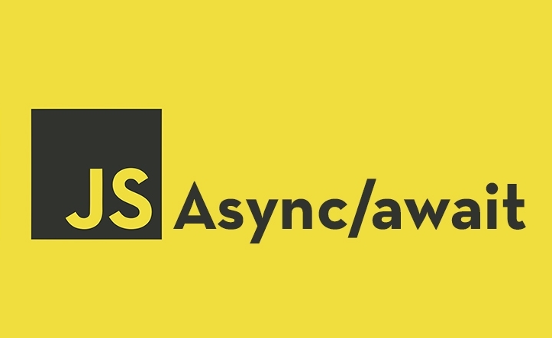
Async Function
An async function simplifies asynchronous code by returning a Promise.
Declared using the async keyword before the function keyword.
An async function fulfills the Promise by returning a value or rejects it by throwing an exception.
Notes:
An async function helps handle asynchronous operations in JavaScript by returning a promise. It is declared using the async keyword before the function definition. The function either fulfills the promise by returning a value or rejects it by throwing an error. This approach makes asynchronous code easier to read and manage. Next, we will see how async functions work with the await keyword.

Slide 3
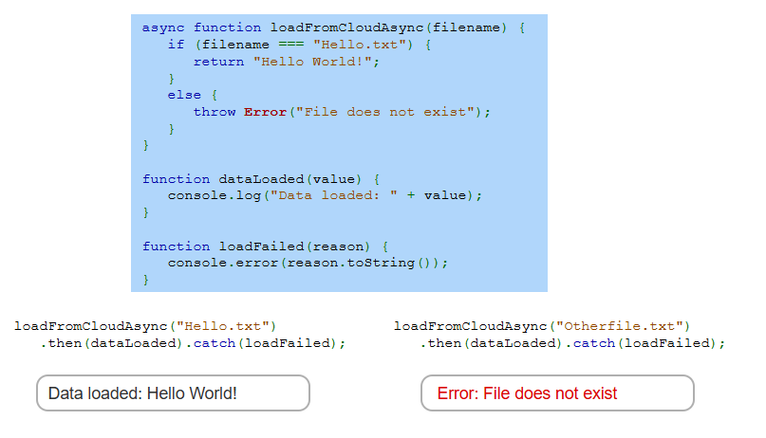
Example
Notes:
Here is an example of an async function handling promises. The function checks if the file name matches Hello dot txt and returns Hello World. If the file does not exist, it throws an error. The then method processes the returned value, while catch handles errors. In this case, one call succeeds while the other fails. Now, let us move forward and explore the await keyword for handling async operations more effectively.

Slide 4
Await Keyword
The await keyword pauses execution until a Promise resolves.
Used inside an async function to wait for an asynchronous operation before moving to the next statement.
Once the Promise resolves, execution resumes from the next statement in the async function.
Notes:
The await keyword pauses execution until a promise resolves, making asynchronous code easier to manage. It is used inside an async function to wait for an operation to complete before moving to the next statement. Once the promise resolves, execution resumes from the next line in the function. This helps avoid callback nesting and makes the code more readable. Next, we will see an example of await in action.

Slide 5
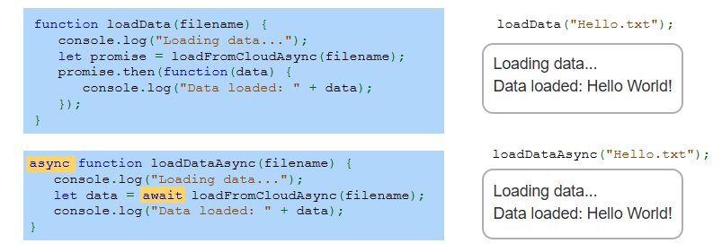
Example
Notes:
This example compares using promises with then and using async await. The first function loads data using a promise and processes the result inside the then method. The second function, marked as async, uses await to pause execution until the data is loaded. This makes the code more readable and easier to manage. Both approaches achieve the same result, but async await simplifies handling asynchronous tasks.

Slide 6
Async Functions
Async functions handle rejected Promises using a try-catch statement.
If a Promise is rejected, the Error object is caught in the catch block.
This prevents crashes and allows handling errors gracefully.
Notes:
Async functions handle errors using a try catch statement. If a promise is rejected, the error object is caught inside the catch block. This helps prevent crashes and allows us to manage errors gracefully. Instead of using the then and catch methods separately, try catch keeps error handling clean and readable. Next, we will see an example of using try catch in an async function to handle rejected promises.

Slide 7
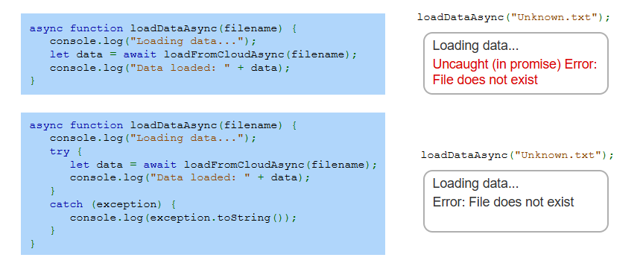
Example
Notes:
This example shows error handling in async functions. The first function does not handle errors, causing an uncaught promise rejection when the file does not exist. The second function uses try catch to handle the error, preventing the program from crashing and displaying a clear message. Using try catch in async functions improves reliability and makes debugging easier. Next, we will see more advanced async techniques.

